Slide 1
How can we construct new buildings with a zero-carbon budget in the future? Filip Elland, Chief Sustainability Officer

Slide 2
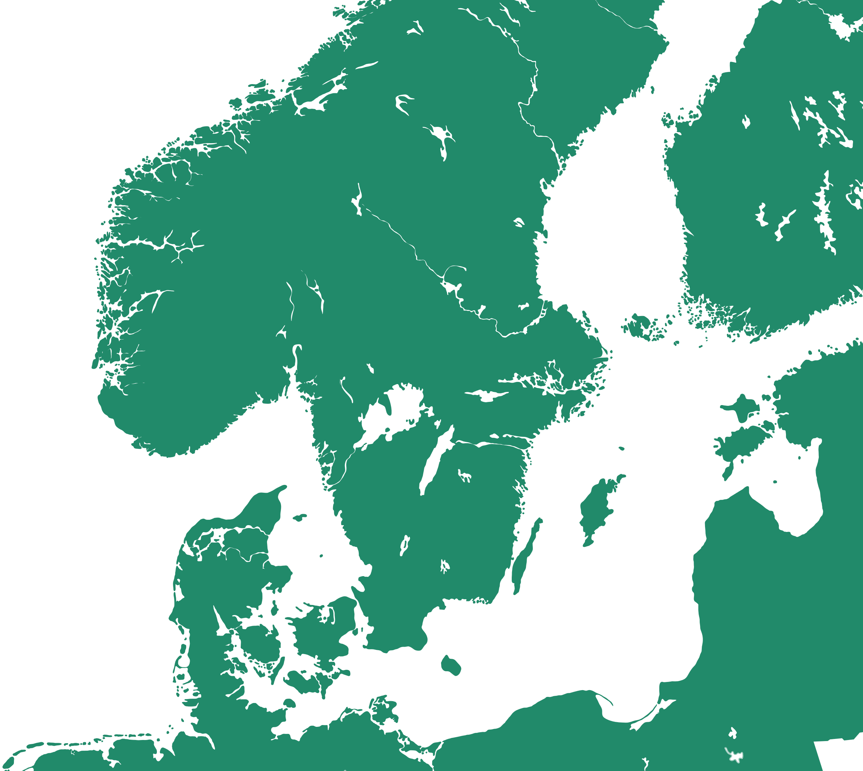
Leader in the Nordic region
Trondheim
Östersund
One of the largest listed property companies in the Nordic region
Property value SEK 160 Bn* – of which 73% in metropolitan areas
5.5 million sq. m. lettable area
50% of sq. m. sustainability-certified properties
Yearly contract value approximately SEK 9.2 Bn
Tampere
Lahti
Turku
Vantaa
Bergen
Helsinki
Espoo
Sandvika
Oslo
Uppsala
Stavanger
Drammen
Västerås
Örebro
Stockholm
Norrköping
Borås
Linköping
Gothenburg
Jönköping
Växjö
Helsingborg
Copenhagen
Lund
*Including holdings in Entra
Malmö
Operational regions
Indirect operational regions (via Entra)
Notes:
We are a leader in the Nordic region, located in growth regions throughout; with our holdings in Entra we also have a presence in the Oslo region of Norway.
Altogether, our properties have a lettable area of 5.6 million square metres.

Slide 3
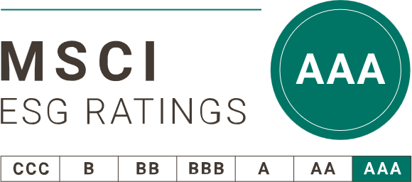
Castellum is the leading and most sustainable commercial property company in the Nordics
Score 82/100
Rating AAA
Ranking #1 in the category Property development
Remains one of a few major property companies in the Nordics to be approved and classified

Slide 5
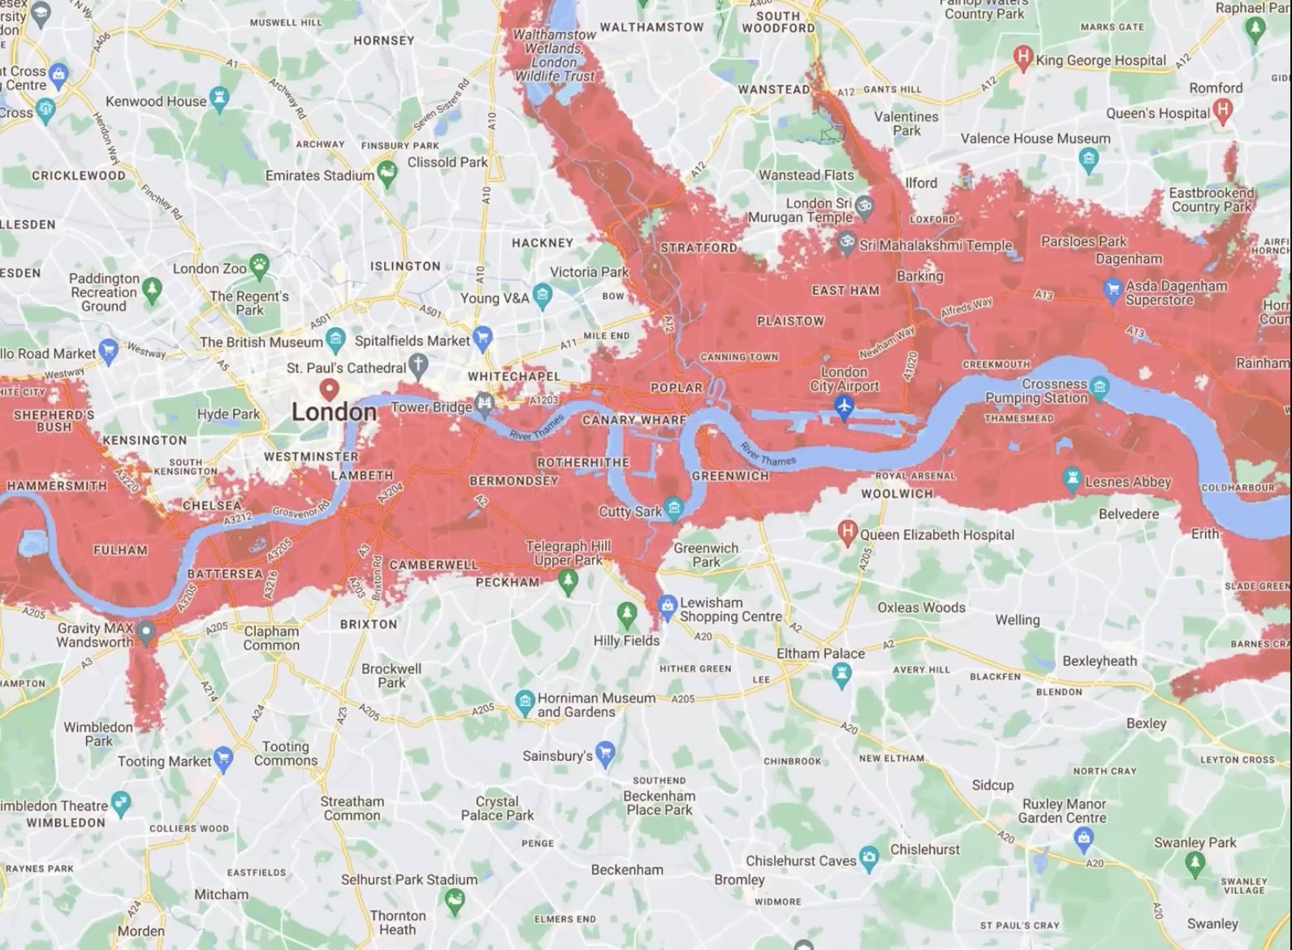

Slide 6
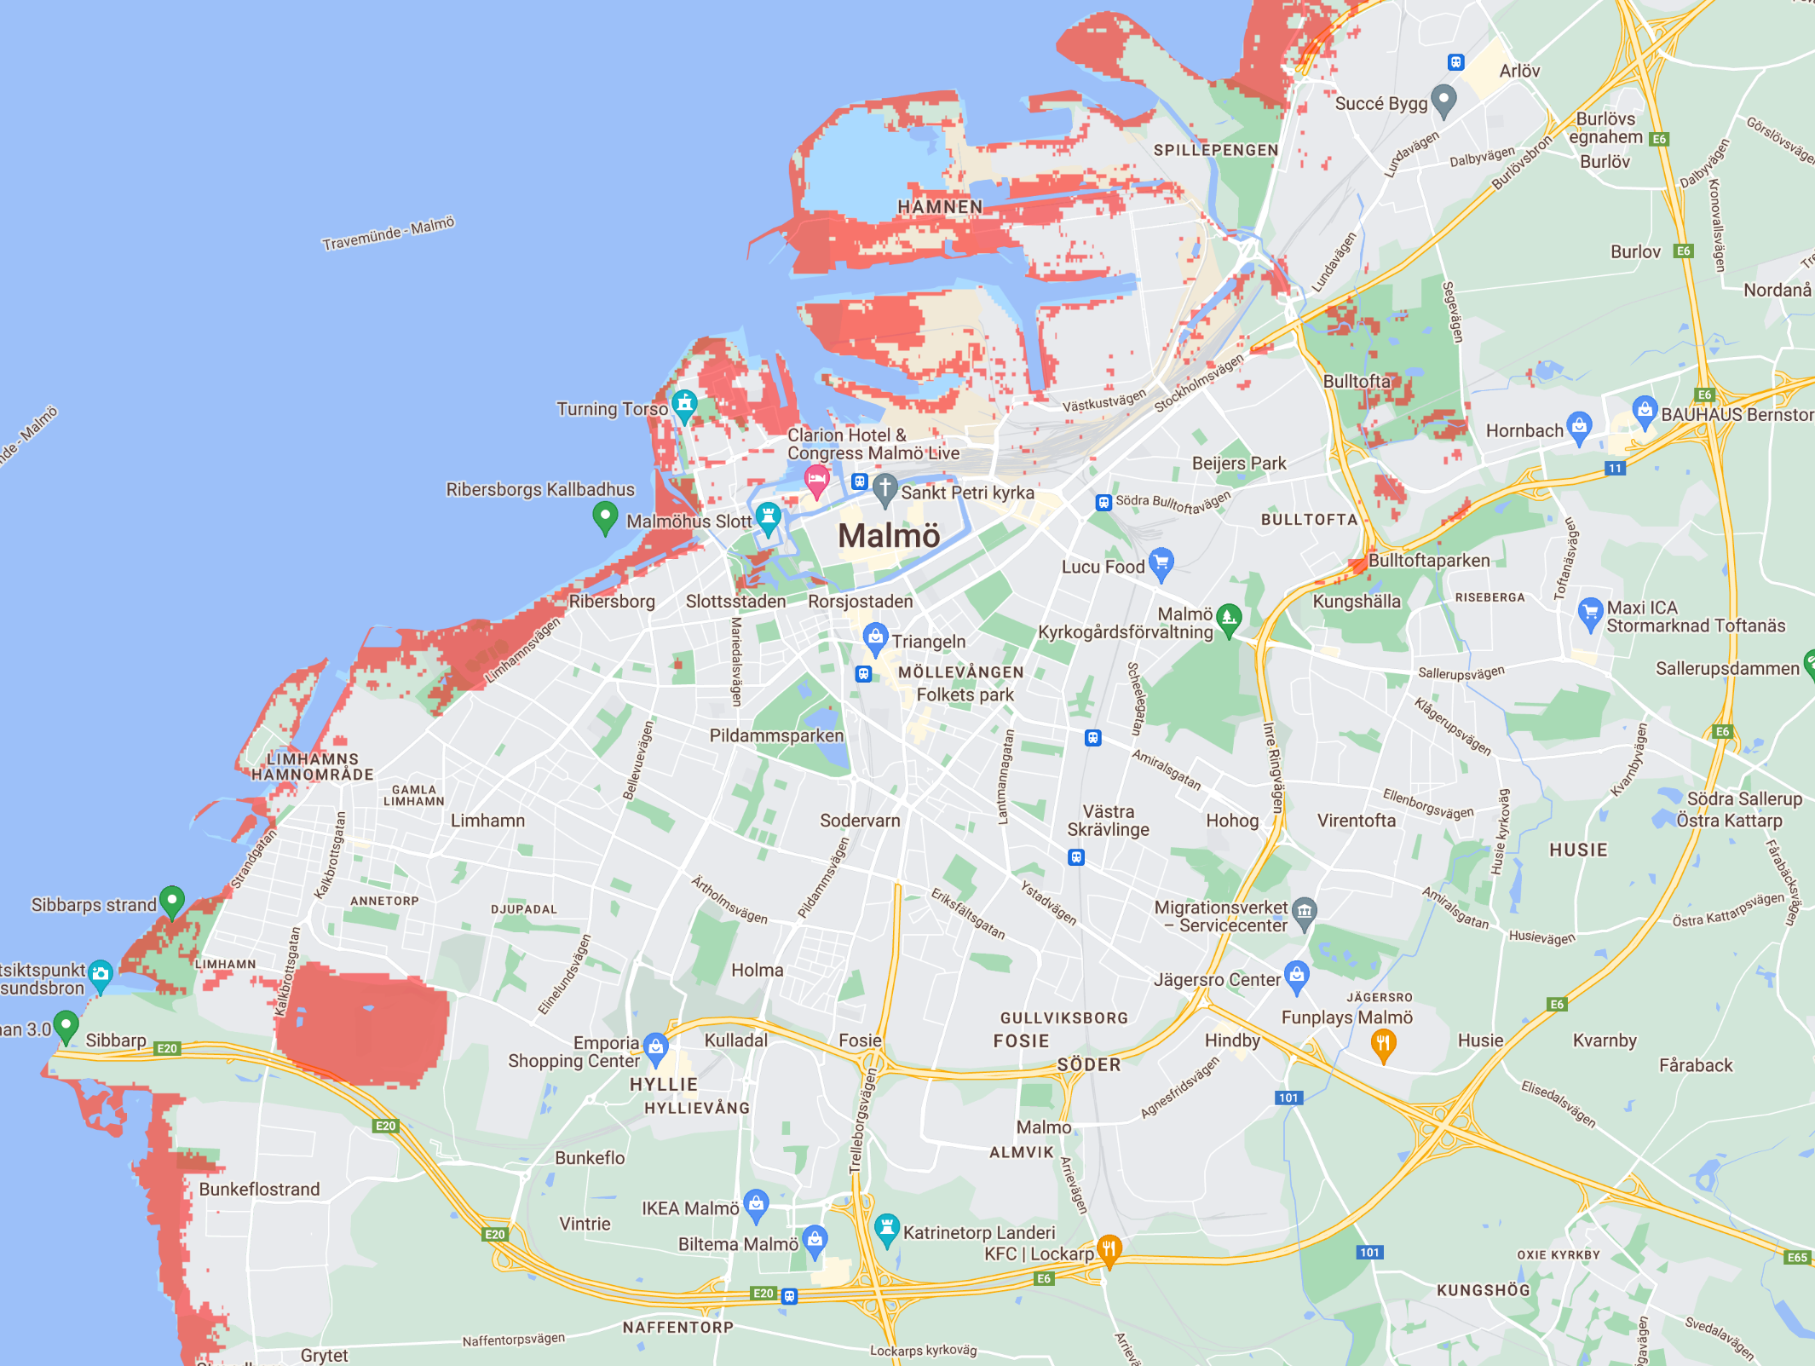

Slide 7
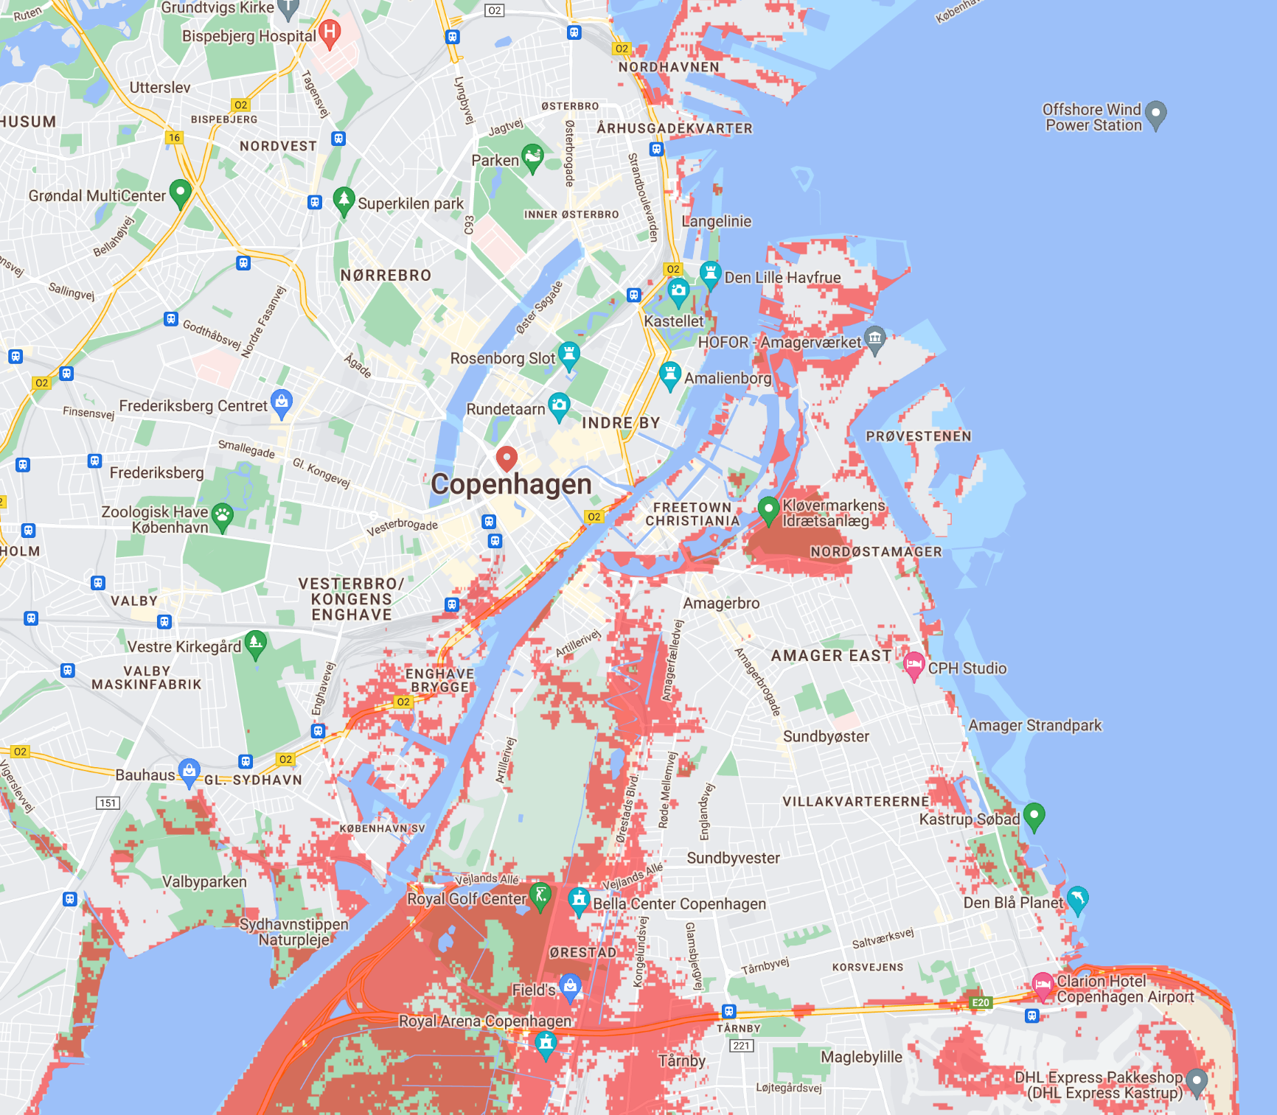

Slide 8
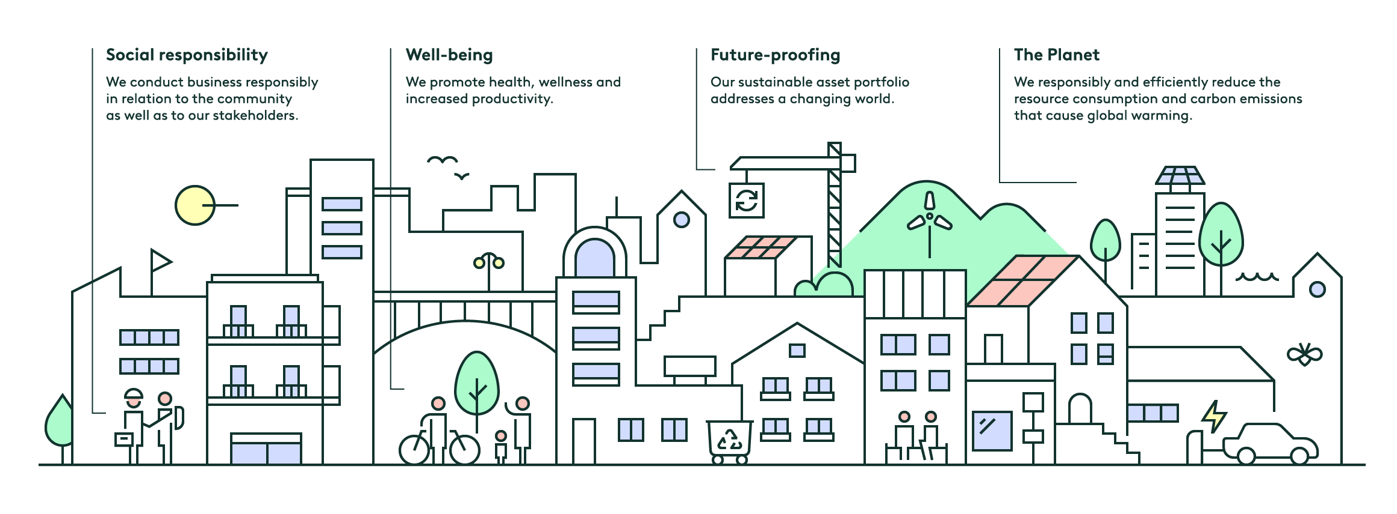
The sustainable city 2030
Ongoing targets
2.5% energy conservation
Re-use in all projects
10% trainees from education or outside the labor market
Target 2025
70% energy performance <100 kWh/sqm, year
100 major solar installations
50% sustainability certified properties
Target 2030
Net zero carbon emissions, approved by the Science Based Targets initiative
Net zero in road map Property management
Net zero in road map Property development
Net zero in road map Customer journey
Long-term targets
100% < 50 kWh/sq. m., year
No properties with severe climate risks
8
Notes:
Over time, Castellum will be the most sustainable commercial property company in the Nordic region and will actively promote sustainable development. This is the starting point of our sustainability strategy, “The sustainable city 2030”, which deals with how we can efficiently reduce our use of resources, how we can promote health and wellness, and ensure that we are conducting our operations responsibly.
The Planet: We will responsibly and efficiently reduce resource use and carbon emissions that cause global warming.
Future-Proofing: We will create a sustainable asset portfolio in a changing world.
Well-being: We will promote health, wellness and productivity.
Social Responsibility: We will conduct business in a responsible manner in relation to the community as well as to our stakeholders.

Slide 9
E.ON Nordic head office, Malmö
BREEAM Outstanding, WELL Platinum. Primery energy demand of 35 kWh/sqm, year (near zero energy building)
Notes:
E.ON head office in Malmö
BREEAM grade, Outstanding, WELL grade, Platinum.
Primery energy demand of 35 kWh/sqm, year (near zero energy building)
An office building that, from a sustainability perspective, is extraordinary.
100% renewable electricity.
WELL and BREEAM certified at the highest level.
Focus on health.
Roof terrace with outdoor office, meeting rooms, plant boxes, an outdoor gym, beehives and biotope roofs.

Slide 10
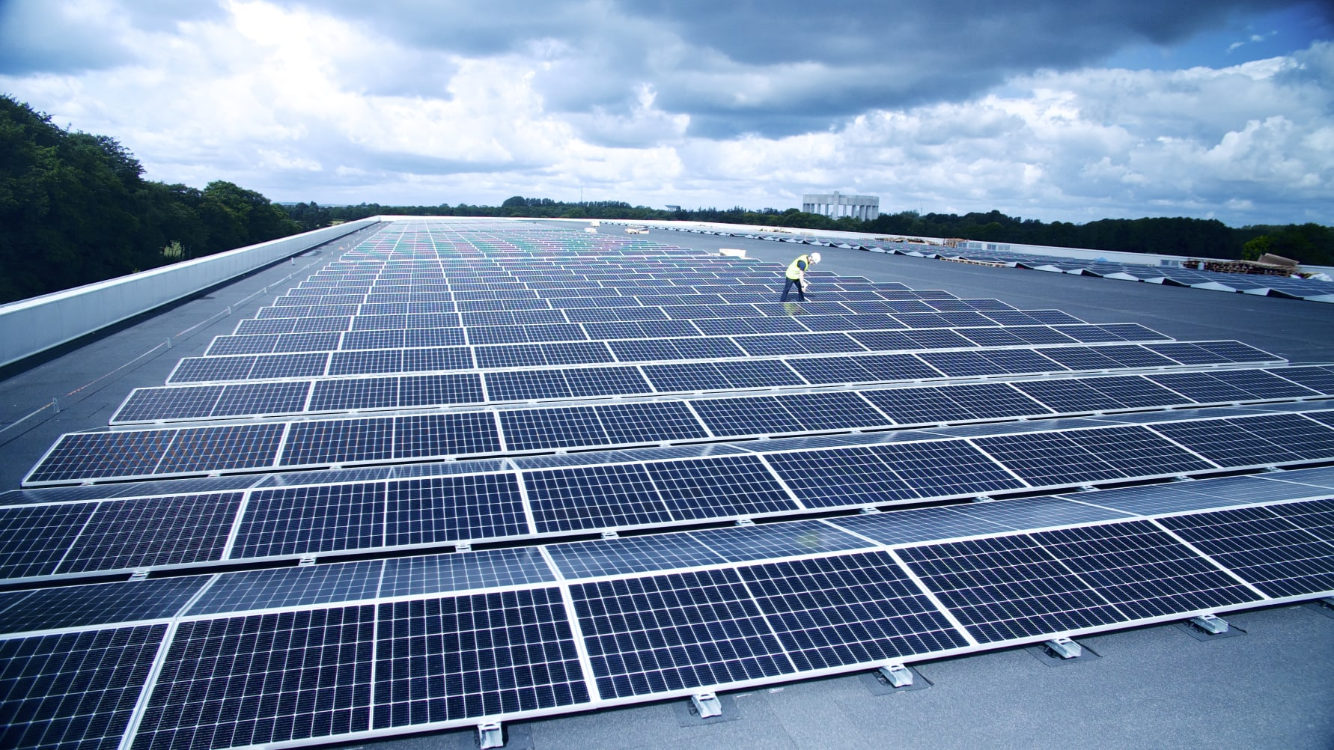
Drevet, Helsingborg
Third largest solar installation in the Nordic market on rooftop 2023. 20 000 kvm, 4 254 panels, 1 800 kW
Notes:
Third largest solar installation in the Nordic market on rooftop 2023. 20 000 kvm, 4 254 panels, 1 800 kW
Castellum installs battery storage in Helsingborg and enter the electricty flexibility market.
Large battery of 430 kW and weights 6 tonnes

Slide 11
Northvolt, Västerås
Effekten, Västerås
LEED level Gold and NollCO2-certification
Approx 45% reduced embodied carbon emissions
Notes:
Castellum is building new offices for Northvolt in the Finslätten district of Västerås.
will be LEED Gold certified.
Near-zero carbon emissions.
Symbiotic building.

Slide 12
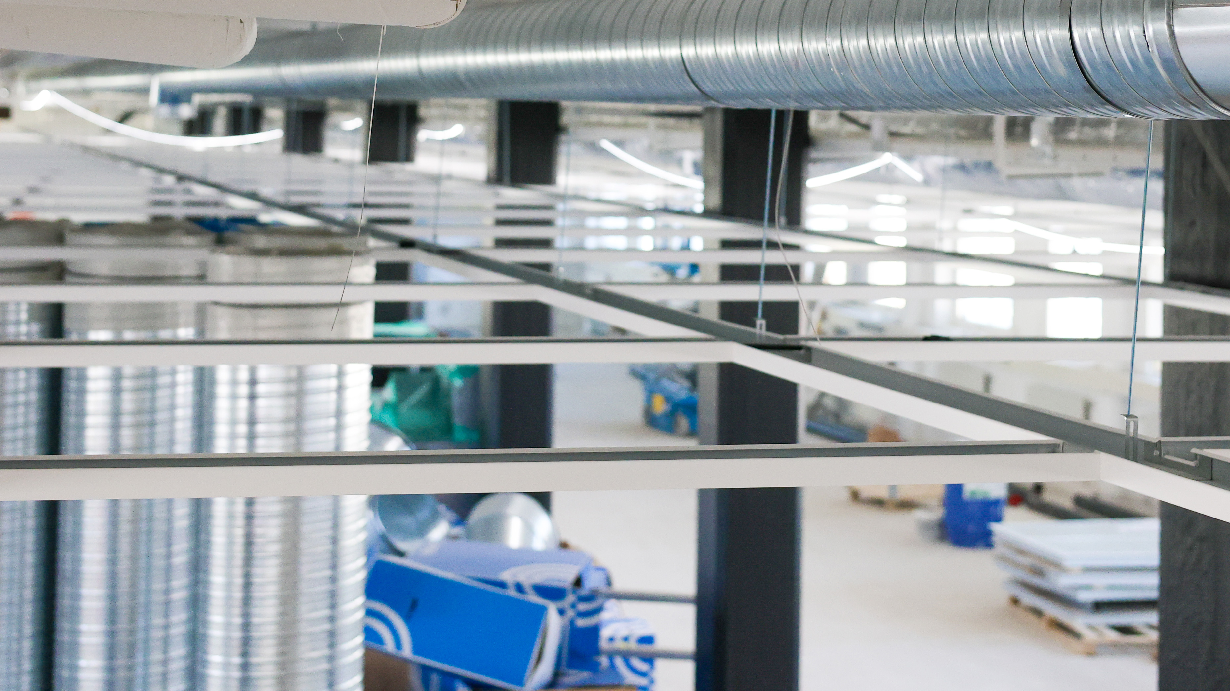
Lindab and Castellum are collaborating on duct systems in fossil-free steel for a renovation project in Stockholm, Sweden. Lindab is the first ventilation company in the world to receive a pilot delivery of fossil-free steel from SSAB

Slide 13
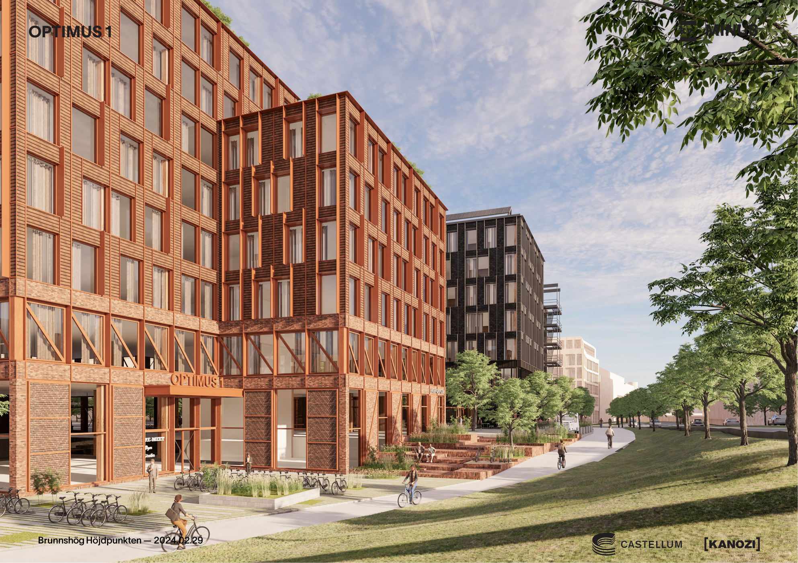
Planned for 2028, 80 % reduction (70 kg/sqm)

Slide 14
Thank you!

